Slide 1
Introduction to Chapter 5
Kelly Hinson

Slide 2

Question: What are the 3 programming structures?

Slide 3
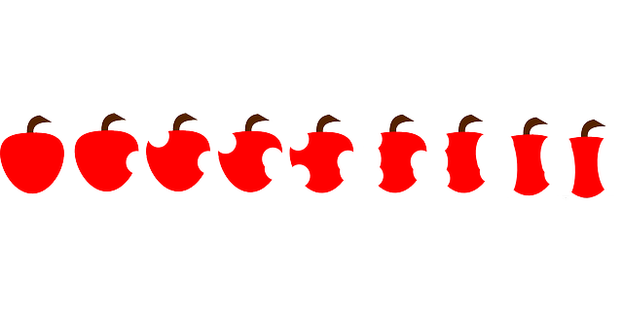


Answer: What are the 3 programming structures?
Sequence
Selection

Slide 4


Selection

Slide 5
Example 1
if (condition)
statement;
//endif

Slide 6
Example 2
if (condition)
{ more than one statement;
}
//endif

Slide 7

Question: In the selection structure, does the ; go at the end of the if statement condition?

Slide 8

Answer: In the selection structure, the ; does not go at the end of the if statement condition.

Slide 9
Question: In the selection structure, does the ; go at the end of the each statement after the condition?
if ( the shirt is red)
wash it;
//endif
if (count < 10)
cout<<“The count is “ << count;
//endif

Slide 10
Answer: In the selection structure, the ; goes at the end of the each statement after the condition.
This is the condition statement.
if (count < 10)
{ count = count +1;
cout<<“The count is “ << count;
}
//endif

Slide 11
toupper or tolower
Converts a character variable (char) to upper or lower case, no matter what the user enters on the screen.
Functions
Example
toupper(letter)
tolower(letter
Example
toupper(variable name)
tolower(variable name)

Slide 12
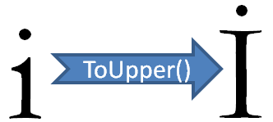
Question: Why use toupper or tolower?

Slide 13
Answer: To have control over incoming data.
If the user enters a letter on the screen, do you want to have to ask every time if it is a capital or lowercase?
Use toupper or tolower to make comparisons easier.

Slide 14
#include <iomanip>
This is a new directive to put in your program when you are going to use setprecision or fixed or scientific stream manipulators.

Slide 15
setprecision & fixed
Are stream manipulators
Allows you to control the number of decimal points displayed on the screen.
double sales = 3500.6;
cout <<fixed;
cout <<setprecision (2);
cout<< sales;
Sales will display as 3500.60

Slide 16
Question: If you have more than one statement under the if condition, what else is required?
if (sales <= 16.67)
sales = 16.67;
Cout << “You did not make many sales!” << endl;

Slide 17
Answer: You need brackets!
if (sales <= 16.67)
{
sales = 16.67;
Cout << “You did not make many sales!” << endl;
}

Slide 18
Question: Which of the following statements is correct?
Example A
Example B
if (a = 100)
cout << “Great Job!”;
//endif
if (a == 100)
cout << “Great Job!”;
//endif

Slide 19
Answer: Which of the following statements is correct? B, because it is a comparison.
Example A
Example B
if (a = 100)
cout << “Great Job!”;
//endif
if (a == 100)
cout << “Great Job!”;
//endif

